Slide 1
SECURE DATA HIDING IN IMAGES USING STEGANOGRAPHY
CAPSTONE PROJECT
Presented By:
Student Name : SRAVAN PASALA
College Name & Department : KMM INSTITUTE OF POSTGRADUTES STUDIES AND COMPUTER SCIECENE

Slide 2
OUTLINE
Problem Statement
Technology used
Wow factor
End users
Result
Conclusion
Git-hub Link
Future scope

Slide 3
Problem Statement
- Need for secure data transmission
- Encryption raises suspicion
- Steganography hides data inside images
- Ensures confidentiality & security

Slide 4
Technology used
- LSB Steganography
- Python Programming
- Cryptography Libraries
- Image Processing Techniques

Slide 5
Wow factors
- Invisible data embedding
- No significant image distortion
- Secure & undetectable communication
- Can be used with encryption for extra security

Slide 6
End users
- Cybersecurity Professionals
- Government Agencies
- Journalists & Activists
- General users for private communication

Slide 7
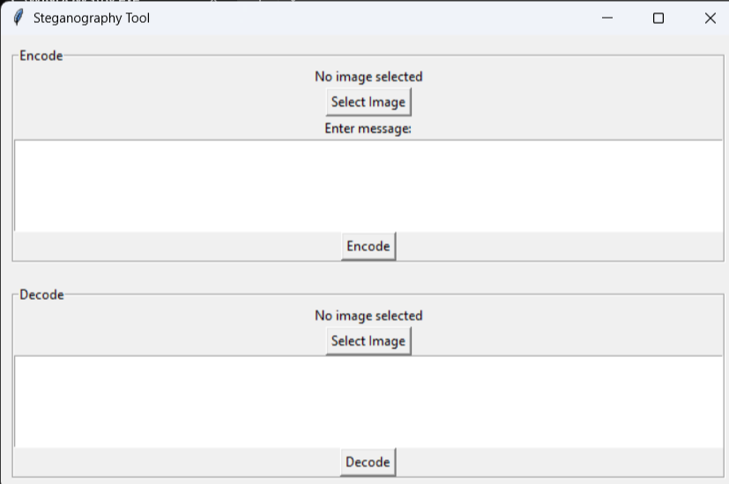
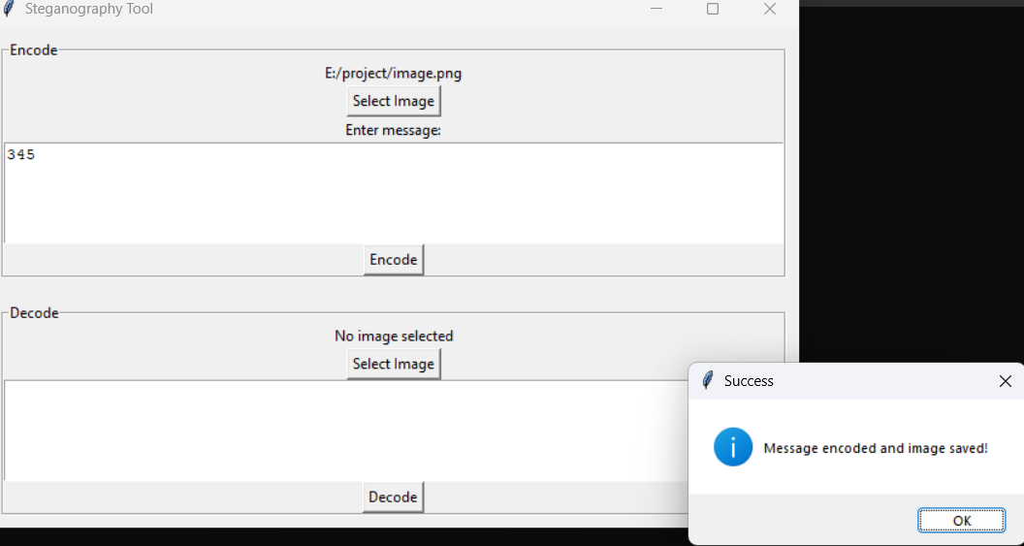
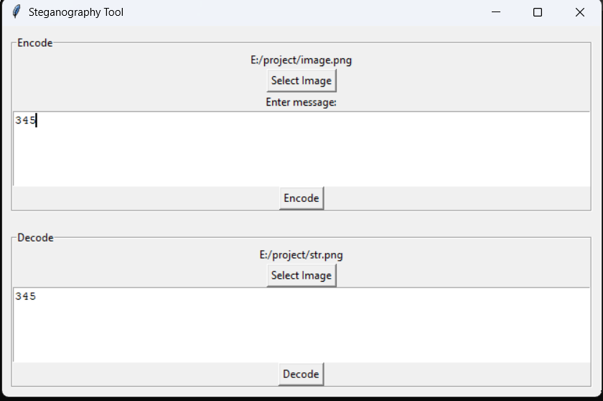
Results
)

Slide 8
Conclusion
- Steganography enhances data security
- Provides covert communication
- Effective in various real-world scenarios
- Can be combined with encryption

Slide 9
GitHub Link
https://github.com/pasalasravan/steganography-Aicte-project.git

Slide 10
Future scope(optional)
Improve resistance to detection
- Increase data capacity per image
- Support various file formats
- AI-driven automated embedding & extraction

Slide 11
THANK YOU

